Slide 1
Speech to text Generation with sentimental Analysis
Mentor: Dr. Himangshu Sarma
Group: 27
Vaka Yagna Karthik - S20170010170
Sai Santosh Chirag - S20170010134
Hemanth Phaneendra- S20170010048

Slide 2
Motivation:
Some people can’t write English accurately it means they have grammar mistakes so for them our product helps them a lot.
Some people might be lazy to type so for them also it helps a lot.
Some people might be physically handicapped so for them if they want to do their works.
It also helps to detect bad words using sentimental analysis and our product automatically removes them instead to delete the whole comment by owner.

Slide 3
Main topics
Speech to text
Language translation
Sentiment Analysis
Text generation

Slide 4



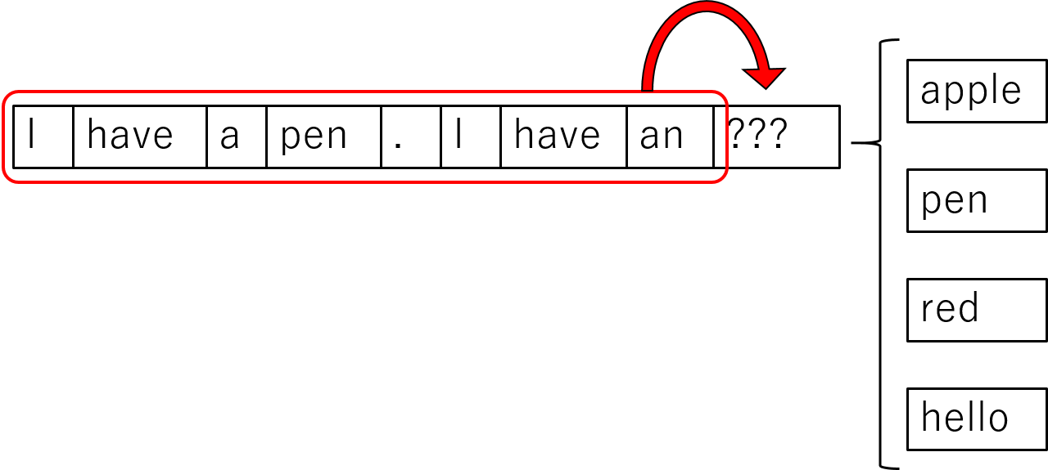

Work flow:

Slide 5
Implementation:
Speech to Text:
We used Speech recognition package and Pyaudio
Recognizer class and API
Language translation:
In this module we used google cloud
It supports a total of 107 languages
There are ‘inp_text’ and ‘target’ in this module. They are source language and destination language.

Slide 6
Continuation…
Sentimental Analysis:
Remove special characters from text
Lemmatize the text
After above two steps we append into a normalized list
We find the sentimental analysis to this corpus( normalized list )
Detection of wrong words.

Slide 7
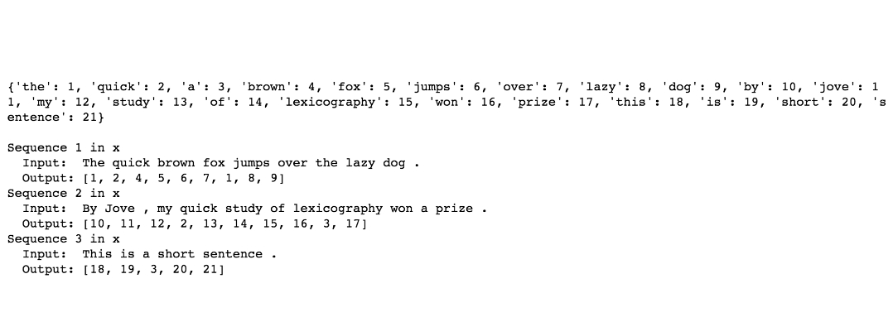
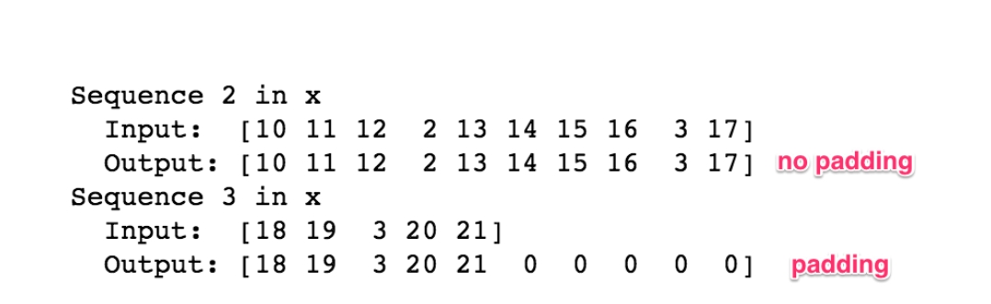
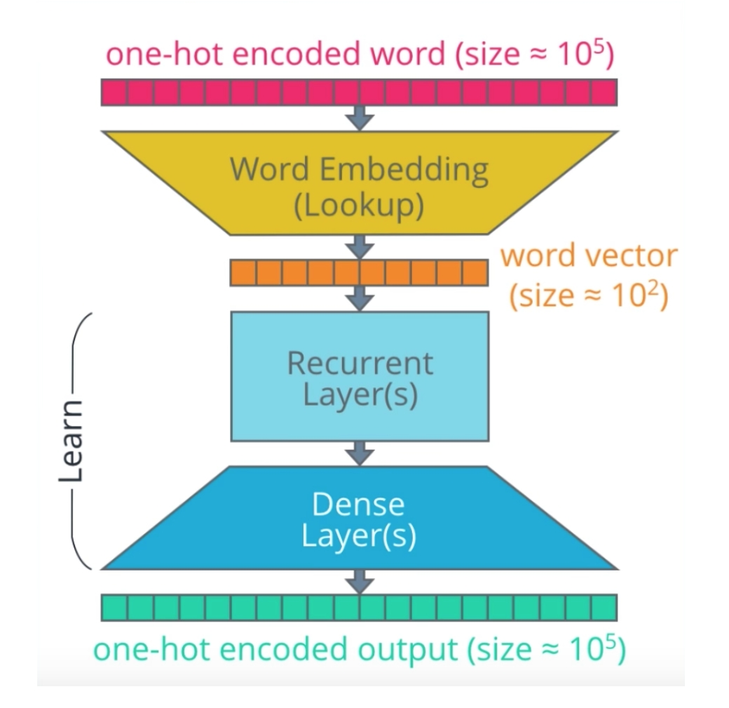
Continuation…
Text generation:
Data cleaning
Tokenization
Implement n-grams
Padding
One-hot encoding
Modeling (input → embedding layers → Recurrent layers → Dense layers → Output)
Predicting the words

Slide 8
Datasets:
Alice’s adventure story book.
Harry potter story book
Twilight story book

Slide 9
Work progress
Implementing in Django . (completed)
Improving sentimental analysis to detect wrong or bad words. (completed)
Improve our text generation model to even generate the texts in other languages.(completed)

Slide 10
Thank you

